Slide 1


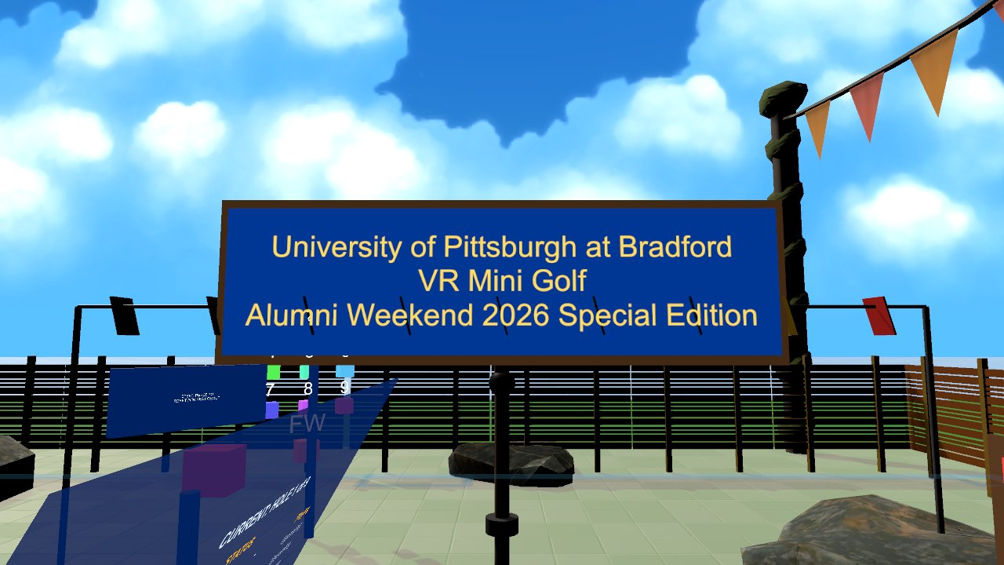

Virtual Reality
Best practices, future trends, and collaborating on GitHub
Wednesdays at 6:00pm
CIST 1423 - 2010 VIRTUAL REALITY PROGRAMMING AND TECHNOLOGY
Lab: pair programming and peer code review with branches and pull requests

Slide 2



Agenda
XR best practices
Trends
Collaboration
Hardware, audience, project management, UX
Where XR is heading, useful toolkits
Branches, pull requests, reviews

Slide 3

Today
By the end of class you can…
Apply comfort, performance and UX rules to your project
Tonight's plan
1
0–10
Review
Name current XR trends and useful toolkits
2
10–40
Best practices + trends
40–50
Lab briefing
Branch, open a pull request, and review a classmate's code
3
50–130
Lab: pair programming + PR review
130–145
Share-out
145–150
Exit ticket
CIST 1423 — Week 13 — Best Practices, Future Trends & Collaboration (Ch. 9)

Slide 4




Best practices from Ch. 9, and from our lab
Most VR discomfort is a design bug, not a user problem.
Hardware
Audience
Hold 90 Hz (Vive Pro 2) / 72+ Hz (Quest)
Bake lighting, limit realtime shadows
Profile in the headset, not the Editor
First-timers at Alumni Weekend ≠ gamers
GolfVR added "fetch putter" and "reset ball" buttons for first-time players
Project management
Comfort & UX
Small vertical slices you can demo
Design log + issues on GitHub
Cut scope before the showcase, not during
Teleport over smooth locomotion for new users
Never move the camera without the player
UI 1–2 m away, large text, no head-locked panels
CIST 1423 — Week 13 — Best Practices, Future Trends & Collaboration (Ch. 9)

Slide 5






Trends worth watching
What changed just in this course's examples.
Mixed reality is default
The spatial web
AI in the pipeline
Quest 3 passthrough, Vision Pro
Apps understand your room (planes, meshes)
WebXR, Meta's Immersive Web SDK
Ship a URL, not a store build
Photogrammetry → our Panther model
Code assistants, generated textures and audio
Hands & eyes
Social by default
Toolkits (Asset Store)
Controller-free input
Eye tracking for foveated rendering
Shared spaces, co-presence
Our WaterWorks relay: ~300 lines of Node
SteamVR Plugin, XRI, Meta XR SDK
DOTween, ProBuilder, Cinemachine
CIST 1423 — Week 13 — Best Practices, Future Trends & Collaboration (Ch. 9)

Slide 6


Lab: branch, pair, pull request, review
One driver, one navigator, swap every 20 minutes. Then review each other's PR.
# 1. start from an up-to-date main
git switch main && git pull
git switch -c feature/gaze-dwell
# 2. pair: driver types, navigator reviews, swap every 20 min
git add Assets/Scripts/GazeDwell.cs
git commit -m "Add head-gaze dwell selection"
git push -u origin feature/gaze-dwell
# 3. open a pull request, ask your partner to review
gh pr create --fill
# reviewer: comment on lines, request changes or approve
gh pr review --approve
# 4. merge, then delete the branch
gh pr merge --squash --delete-branch
What reviewers check
Does it run? (pull the branch, press Play)
Names, comments, no dead code
No Library/, Temp/ or giant unused assets
Real example: repo hygiene
This repo's GolfVR: 1.37 GB untracked → 615 MB after ignoring unused Asset Store folders
CIST 1423 — Week 13 — Best Practices, Future Trends & Collaboration (Ch. 9)

Slide 7
Check your understanding
Answer with a partner first, then we'll compare.
Q1
Q2
Q3
Frame-rate target for the Vive Pro 2?
Teleport or smooth locomotion for first-time users?
What should a reviewer check besides "does it run"?
CIST 1423 — Week 13 — Best Practices, Future Trends & Collaboration (Ch. 9)
Notes:
Answers:
Q1. Frame-rate target for the Vive Pro 2?
90 Hz, with no dropped frames.
Q2. Teleport or smooth locomotion for first-time users?
Teleport.
Q3. What should a reviewer check besides "does it run"?
Names, comments, no dead code, no Library/ or huge unused assets.

Slide 8

Next steps: homework + planning
Submit your revised project
Markdown "Collaboration Example": your PR link, the review comments, what you changed
Apply at least two Ch. 9 best practices and say which
Next week: testing and polishing (peer playtests)
CIST 1423 — Week 13 — Best Practices, Future Trends & Collaboration (Ch. 9)

